Slide 1
Rapid Comparison of Protein Structures
A. D. McLachlan , Acta Crystallographica Section A , pp.871-873, 1982.
Presenter : Hsiao-Yen Chang
Date : August 1, 2007

Slide 2
Abstract
An unusually fast method of superposing two
sets of atomic coordinates for related molecular
structures by least squares is described. It exploits
the special nature of the problem and uses the
method of conjugate gradients. The calculation
takes about 0.003s and is fast enough to be used
in on-line graphics systems.

Slide 3
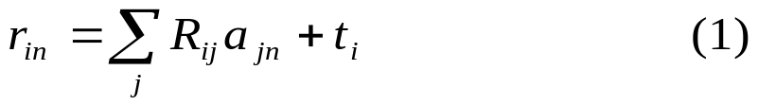
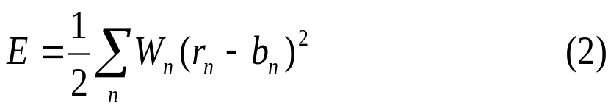
McLachlan algorithm
Let a_{n}, b_{n}, (n = 1 … N) be the position vectors of two sets of atoms from molecular fragments A and B, and w_{n} be a weight for each atom. We wish to find an orthogonal proper rotation matrix R with determinant +1, and a translation vector t which converts the coordinates a_{in} (i = I, 2, 3) to
And minimizes the residual
The best translation t is that which superimposes the centroids of both sets of atoms.

Slide 4

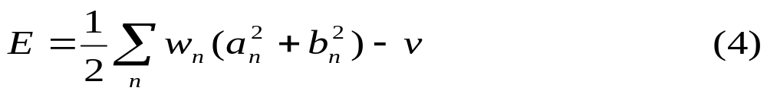
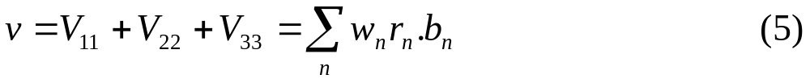
McLachlan algorithm (cont.)
The rotation is derived by considering two special matrices U and V = RU:
Since the residual can be written
Where v is the diagonal sum

Slide 5
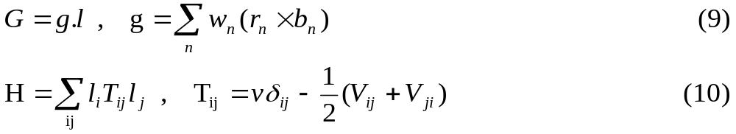
McLachlan algorithm (cont.)
The rotated position then becomes
r' = r cosθ+ (l x r)sinθ+(r. l)1 (1-cosθ) (6)
and the contribution to v from this atom is proportional to
r'. b = (r. b) cosθ + (l × r. b) sinθ + (r. l)(l. r)( 1 - cosθ)
= (r. b) + I. (r × b) sinθ+ [(r. l)(1.b) - (r.b)](1 - cosθ) (7)
Substitution into (4) gives the residual as
E' = E - Gsinθ+ H(1 - cosθ) (8)
Here G and H can be expressed in terms of a vector g and a matrix T both derived from V.

Slide 6
McLachlan algorithm (cont.)
When θ is small the change of E becomes δE = -Gθ + ½Hθ², so that G is the downhill gradient of E about the chosen axis and H is the second derivative.
The problem of minimizing E is equivalent to searching for the rotation R which makes G vanish and H positive for any further choice of movement.
(sin(θ/2))²=(1-cosθ)/2
1-cosθ=2 (sin(θ/2))²
=2 (θ/2)²
=θ²/2

Slide 7
McLachlan algorithm (cont.)
An important consequence of (8) is that the unique minimum of E around a given axis is obtained in only one step from the conditions
sinθ = G/(G² + H²) ^{½} (11)
cosθ = H/(G² + H²) ^{½}
E' - E = H - (G² + H²) ^{½} ≦ 0 (12)

Slide 8
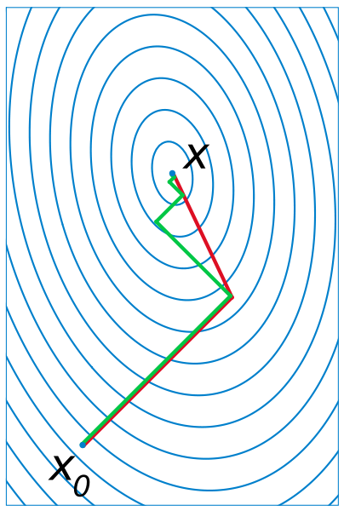
Conjugate Gradient Method
S_{K} = -▽f(x_{k}) + β_{k-1}S_{k-1}
S₀ = -▽f(x₀)
β_{k-1}= | ▽f(x_{k})|² / | ▽f(x_{k-1})|²
(S_{K})^{T}AS_{k-1} = 0
  the n-by-n matrix A is symmetric (A^{T} = A) and positive definite (x^{T}Ax > 0 for all non-zero vectors x in R^{n}).

Slide 9
Conjugate Gradient Method (cont.)
The standard conjugate gradients procedure (Walsh, 1975) chooses the successive rotation axes to be ‘conjugate directions' in the space of three-dimensional rotations and should ideally reach the minimum in just three steps.
The conjugate axes are chosen by taking each vector l parallel to a path vector s for the step. In the first step the rotation is about the axis of steepest descent, defined by the couple g:
s₁ = g₁ (13)
Later paths each depend on the previous path and couple according to the relation
s_{p+1} = g_{p+1} + (g²_{p+1} / g²_{p}) s_{p} (14)

